Slide 1
Few-Shot Acoustic Synthesis with Multimodal Flow Matching (FLAC)
Amandine Brunetto
Presented By: Olivia Gijo
Notes:
Title can be 30 or 32 pt
Subtitle is 28 pt
Presenter’s name can be in 20 up to 24 pt

Slide 2
CONTENTS
1.Room Impulse Response
2.Motivation
3.FLAC Layout
FLAC Pipeline
VAE
DiT
Flow Matching
AGREE
4.Evaluation
Result
Result comparison

Slide 3
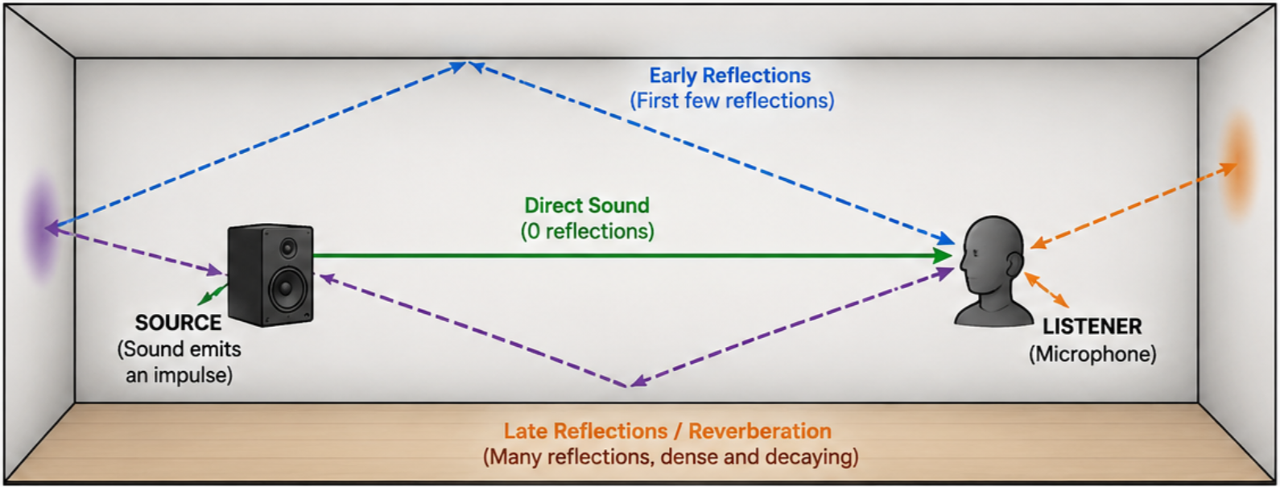
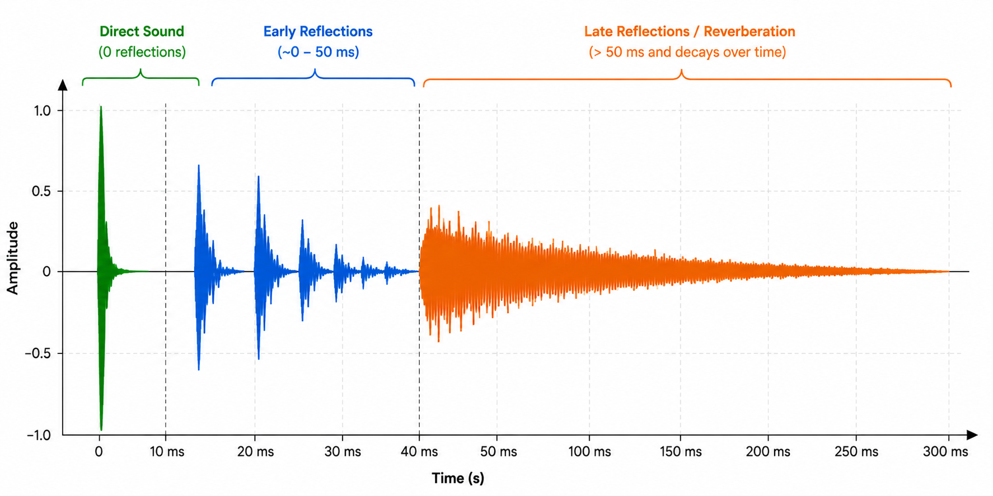
ROOM IMPULSE RESPONSE
What is a Room Impulse Response?
A Room Impulse Response (RIR) describes how a room affects a sound after it is produced, capturing the direct sound ,early reflections and the late reverberation

Slide 4
MOTIVATION
Goal: Generate realistic acoustics in unseen environments from only a few observations with Room Impulse Responses (RIRs) .
Why existing methods are not enough?
Dense training requiring many RIRs and Deterministic prediction
Room acoustics depend not only on geometry but also on unknown material properties.
FLAC captures the uncertainty of room acoustics by generating multiple plausible RIRs instead of a single deterministic prediction
Notes:
Font size is 24 pt, you can use 20 pt as well, but than please stick to it through the entire presentation
The second level font size is 20 or 18 pt (depending on the sice of first level font)

Slide 5
FLAC PIPELINE
Sparse scene inputs
Reference RIR(s)
VAE Encoder
Compress target RIR
into latent z₀
Flow Matching + DiT
Noise interpolation
Predict velocity field
VAE Decoder
Generated RIR
Scene-consistent
acoustic output
Multimodal conditioning
AGREE
Core idea
Replace a single deterministic output with a probabilistic distribution of plausible room impulse responses

Slide 6
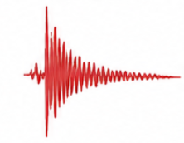
VARIATIONAL AUTOENCODER (VAE)
Input
Real RIR waveform
Encoder
Convolutional blocks
Down sampling
Latent compression
Latent Representation
z₀
Decoder
Reconstructs waveform
Mirror Architecture
Why this matters
Instead of learning directly in raw waveform space, FLAC learns in a compressed latent space

Slide 7

More detailed picture (VAE)
Latent space
Input
• RIR waveform
Encoder
• Conv Blocks ×4
• Feature Extraction
Latent Representation
Mean
μ ∈ R³²
Reparameterization
(Sampling)
ε~N(0,I)
z= μ+ σ ⊙ ε
Log variance
log σ² ∈ R³²
Goal
Compress high-dimensional RIRs into latent space
ere:
Input: Raw Room Impulse Response (RIR)
Output: A compressed latent representation
Latent feature dimension: 32 channels

Slide 8
DIFFUSION TRANSFORMER
Transformer-based neural network that learns the velocity field required by the Flow Matching framework to transform random noise into a realistic Room Impulse Response (RIR)
Conditioning Inputs
Acoustic context ,Spatial context ,Geometric context
OUTPUT
Predicted velocity vector
Flow Matching Inputs
Noisy Latent (zt )
Noise Timestep (t)

Slide 9
FLOW MATCHING
Directly learns the velocity of particles moving along a path for continuous transformation from a simple distribution (Gaussian noise) to a target data distribution(RIRs)
GOAL
How data should flow from random noise to real samples by predicting the direction (velocity) of movement at every point in the generation process.

Slide 10



FLOW MATCHING
Flow matching loss and parameter update
Clean latent z₀
Encoded target RIR
Noise Interpolation
Diffusion Transformer (DiT)
Predicted Velocity
Ground
Velocity
Noise ε
Gaussian noise
Multimodal Conditioning
• Acoustic Context RIRs
• Spatial Positions
• Panoramic Depth Map
Goal: Learn the velocity field

Slide 11

INFERENCE PIPELINE
Gaussian Noise
Diffusion Transformer
Classifier Free Guidance
Backward ODE Integration
Final Latent Representation
Multimodal Conditioning
Generated RIR
VAE Decoder

Slide 12
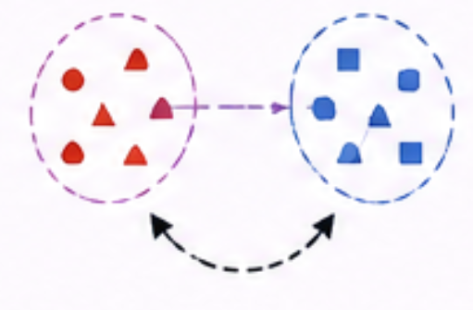

AGREE
Does the generated RIR match the room geometry?
Shared embedding space
geometry-consistency evaluation
Embeddings are aligned
Geometry Branch
Input: room depth
Acoustic Branch
Input: RIR / generated acoustics
Audio Encoder
Geometry Encoder
CLIP-style contrastive model. This introduces Geometry-aware evaluation.

Slide 13
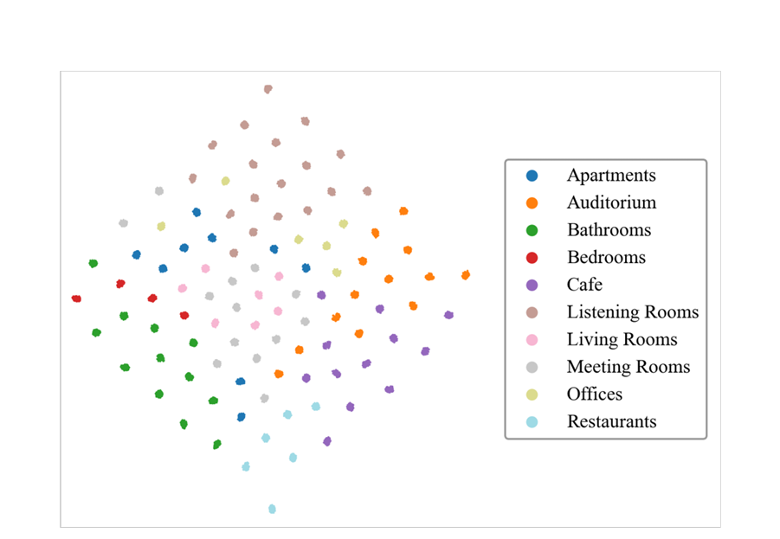
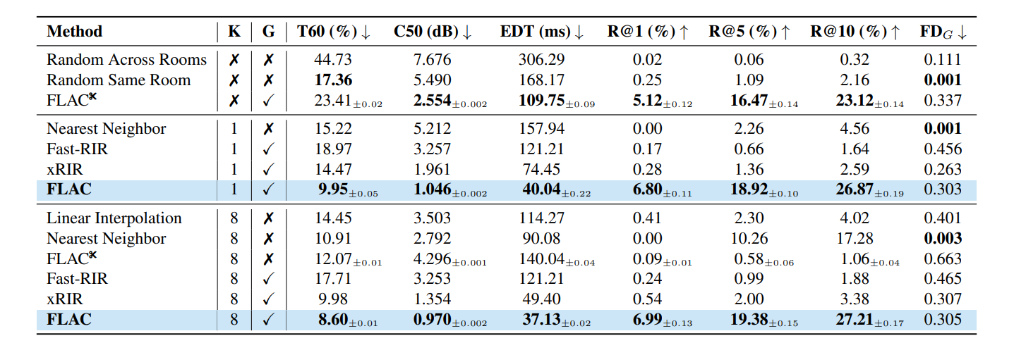
RESULTS
t-SNE visualization of generated RIRs across unseen rooms
Performance on unseen AcousticRooms scenes
FLAC with one reference RIR outperforms previous methods using eight reference RIRs

Slide 14
EVALUATION PIPELINE
Datasets
AGREE
Evaluation Metrics
AR🏠
FLAC
AcousticEncoder
GeometricEncoder
Perceptual Metrics
Scene Consistency Metrics
HAA🌍
Embedding space
Robustness Analysis
FLAC generates RIRs → AGREE evaluates geometry consistency → Final performance

Slide 15
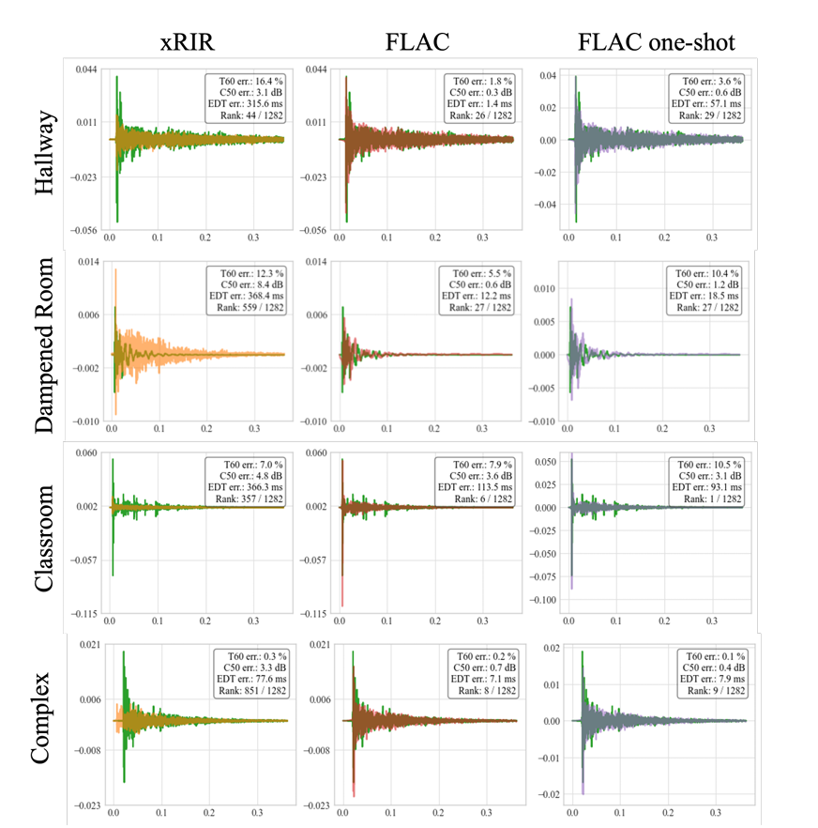
HAA Datasets
Qualitative comparison of predicted RIR waveforms on the real world HAA dataset
We compare xRIR (orange), FLAC (red), and FLAC with K = 1(purple) against the ground truth (green).

Slide 16
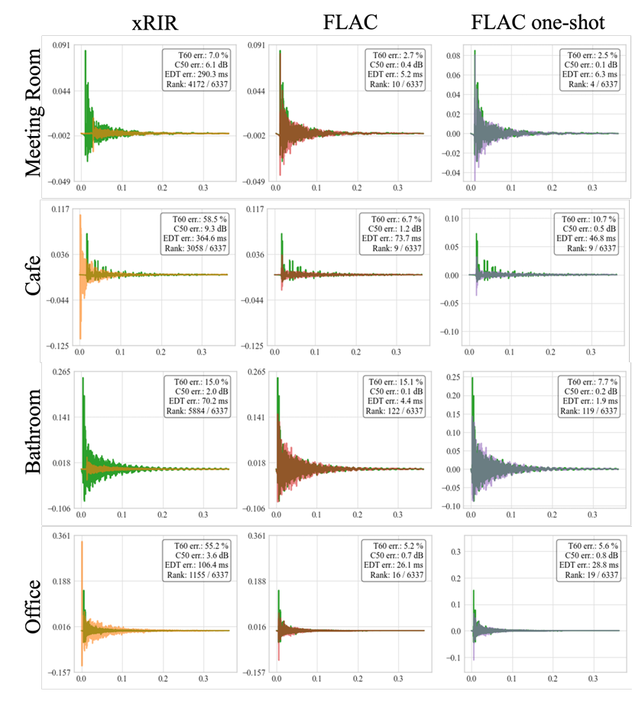
AcousticRoom Dataset
Qualitative comparison of predicted RIR waveforms on the unseen set of the AcousticRooms dataset:
We compare xRIR (orange), FLAC (red), and FLAC with K = 1 (purple) against the ground truth (green).

Slide 17
Results Comparison
CRITERION
PRIOR APPROACHES
FLAC
Data efficiency
Often need dense recordings or several shots
Strong few-shot performance; remains effective with sparse references
Uncertainty modeling
Typically produce one deterministic output
Probabilistic generation of multiple plausible RIRs
Generalization to unseen rooms
Often weaker or needs retraining
Designed to synthesize acoustics in unseen environments
Geometry consistency
Not always explicitly enforced
AGREE provides geometry-aware consistency evaluation
Overall takeaway
Useful but limited under sparse ambiguous settings
Better aligned with the real sparse-observation problem

Slide 18
REFERENCES
Yaron Lipman, Ricky TQ Chen, Heli Ben-Hamu, Maximilian Nickel, and Matthew Le, “Flow matching for generative modeling,” in International Conference on Learning Representations (ICLR), 2023.
Sagnik Majumder, Changan Chen, Ziad Al-Halah, and Kristen Grauman, “Few-shot audio-visual learning of environment acoustics,” in Advances in Neural Information Processing Systems (NeurIPS), 2022.
Xiulong Liu, Anurag Kumar, et al., “Hearing anywhere in any environment,” in IEEE/CVF Conference on Computer Vision and Pattern Recognition (CVPR), 2025
Mason Long Wang, Ryosuke Sawata, Samuel Clarke, Ruohan Gao, Shangzhe Wu, and Jiajun Wu, “Hearing anything anywhere,” in IEEE/CVF Conference on Computer Vision and Pattern Recognition (CVPR), 2024.

Slide 19
Additional Slides for info in case someone asks
Dit internal structure
AdamW optimizer

Slide 20
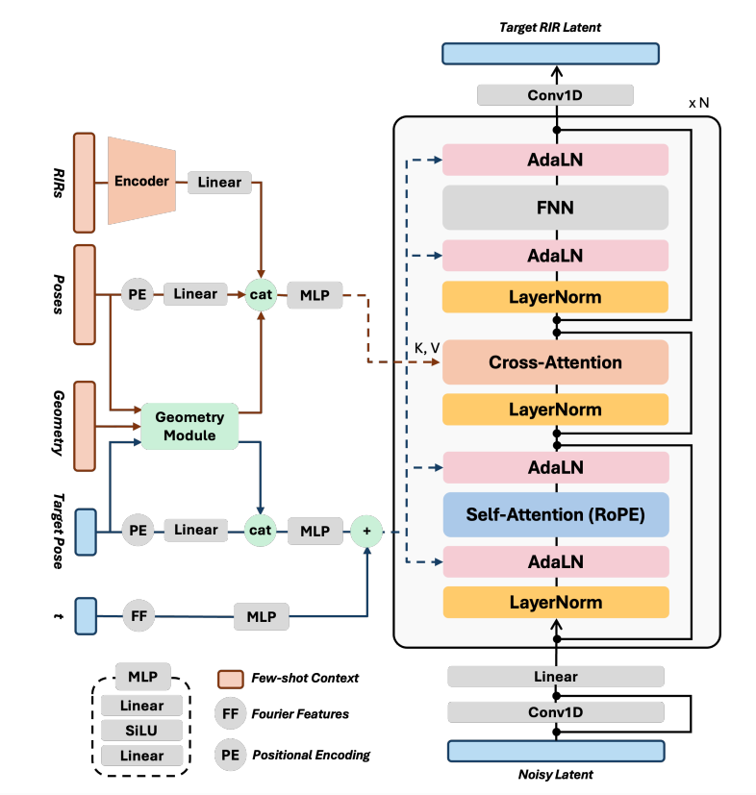
DiT Internal Structure
Self-attention for Latents
Cross-attention for multimodal conditioning
AdaLN normalization as they shift and scale according to the conditioning information
AdaLN makes the Transformer adaptive rather than static.
ADAMw optimizer has adaptive learning rates to reduce loss.
Has two steps:
Gradient update +weight decay

